Slide 1
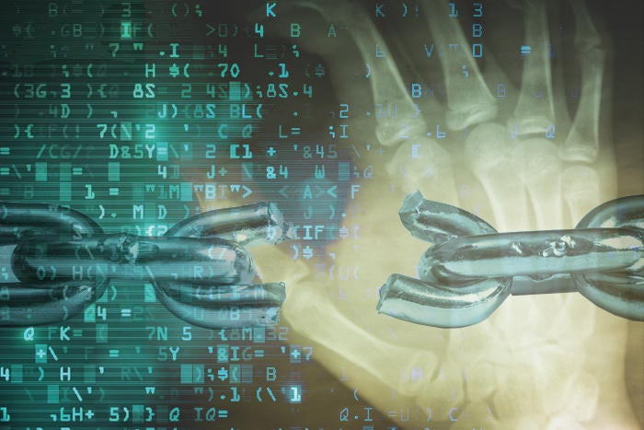
Solar Winds Cyber Kill Chain Analysis

Slide 2
The Kill Chain
Phase | Attack
1.) Reconnaissance | - Possibly gather names of Solar Wind customers from their website - Previous supply chain attack for feedback. Definitely more steps
2.) Weaponisation | Reuse previous Orion codebase with additional backdoor code
3.) Delivery | Directly – used build process of Solar Winds software Indirectly - Supply chain attack using updates
4.) Exploitation | Use of trust between 3rd part and Solar Winds
5.) Installation | Embedded in current Orion application, and using backdoor
6.) Command and Control | Mimic current Orion traffic patterns
7.) Actions on Objectives | Mostly data exfiltration

Slide 3
Mitigation
Phase | Mitigation Tool(s) | Goal
1 | - Website scrapper - Vulnerability assessment recon | Prevent sharing information
2 | (Technical) various techniques (possible tools) (Administrative) Secure SDLC platforms | (Deter) Obfuscate codebase (Prevent/ Detect)Improve SDLC
3 | - (Technical) Hashes | - (Detect) Better comparison of built and delivered code
4 | - (Technical) Docker | - (Prevent) Sandboxing and creation of better zero-trust systems
5 | - (Technical) Docker | - (Prevent) Sandboxing and creation of better zero-trust systems
6 | - (Technical) Intelligent IDS | - Traffic pattern monitoring
7 | - (Technical) File system access privileges, Docker | (Detection) Monitor read records and sources (Prevention/Detection) Possibly improve minimal privileges to files, for certain applications (Prevention) Sandbox application

Slide 4
Summary
There is limited information to base process of attack and possibly mitigations on e.g. lack of current security controls in place, programming languages used, build process, file access requirements for Orion software etc.
Core aspects include how hackers were able decompile source code, and insert a new compromised application into the supply chain
Why were there so many government organisations using the same software platform - redundancy

